Slide 1
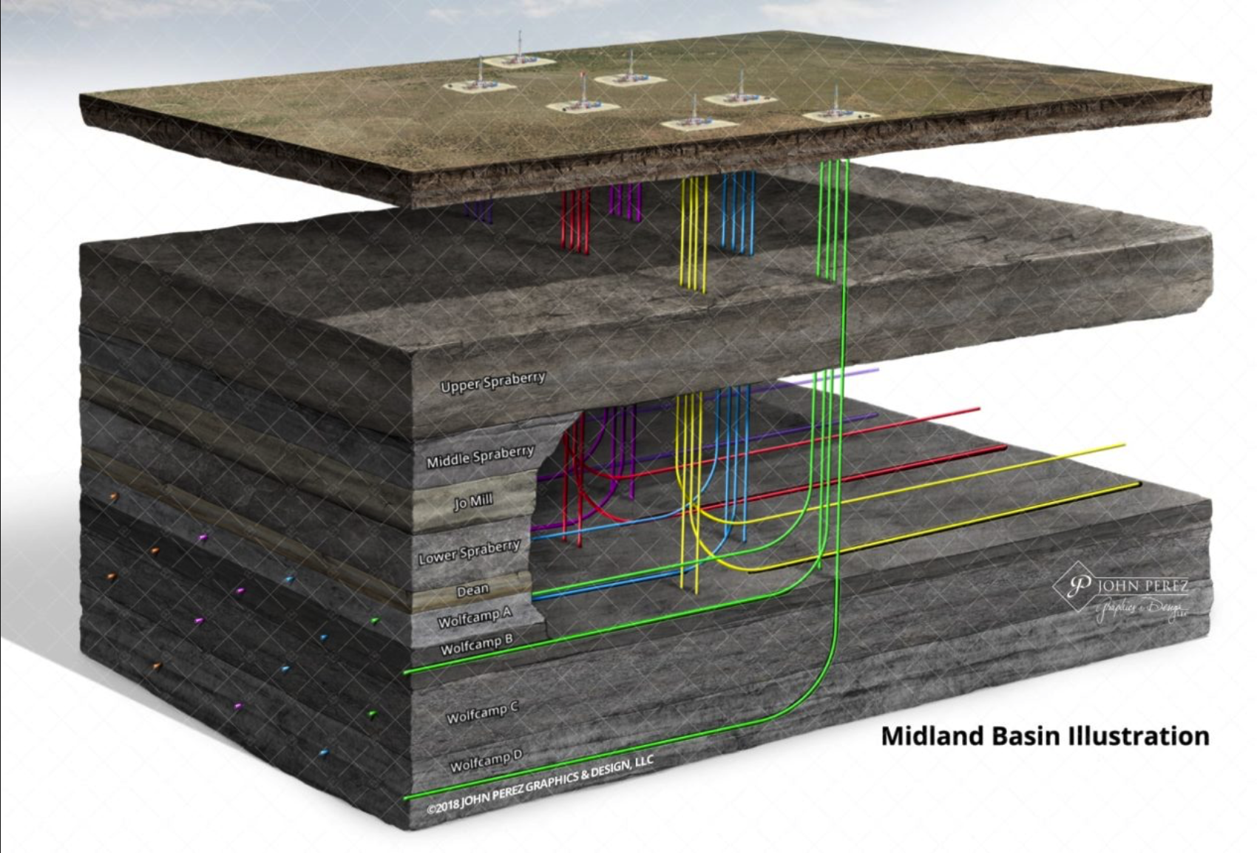
FTNF Report for CTOP
Finding Productive Oil Wells in the West Texas Permian Basin
Peter Flaming Matthew Trevathan Quinton Nixon Brock Friedrich

Slide 2
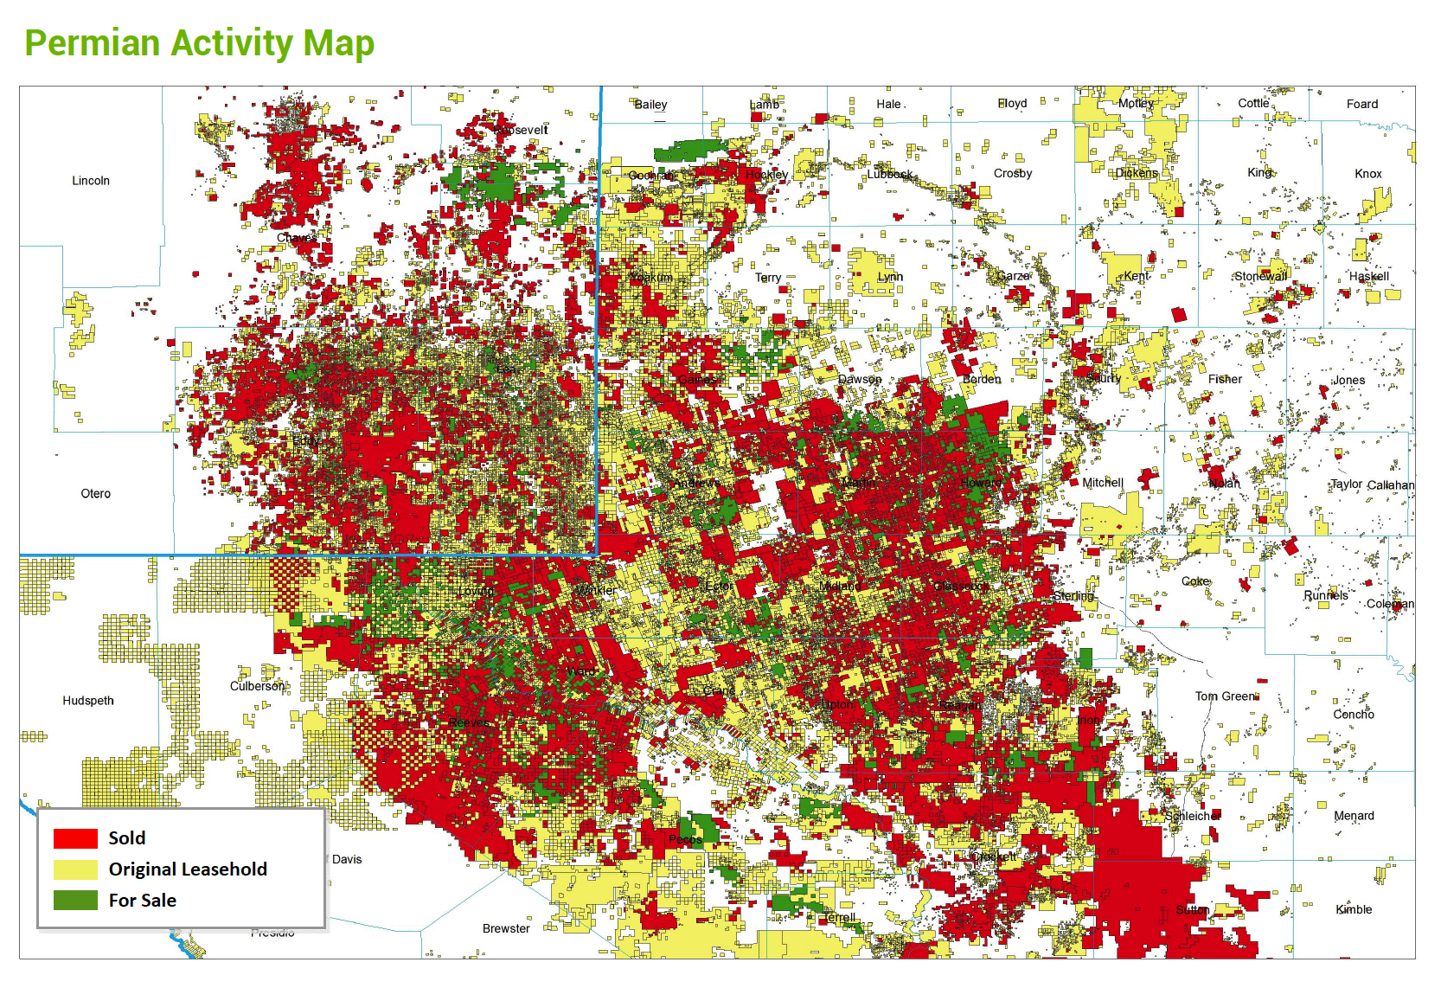

Study Outline
Business Objectives
Data Sourced
Methodology
Evaluation/Results
Summary
Page 2

Slide 3
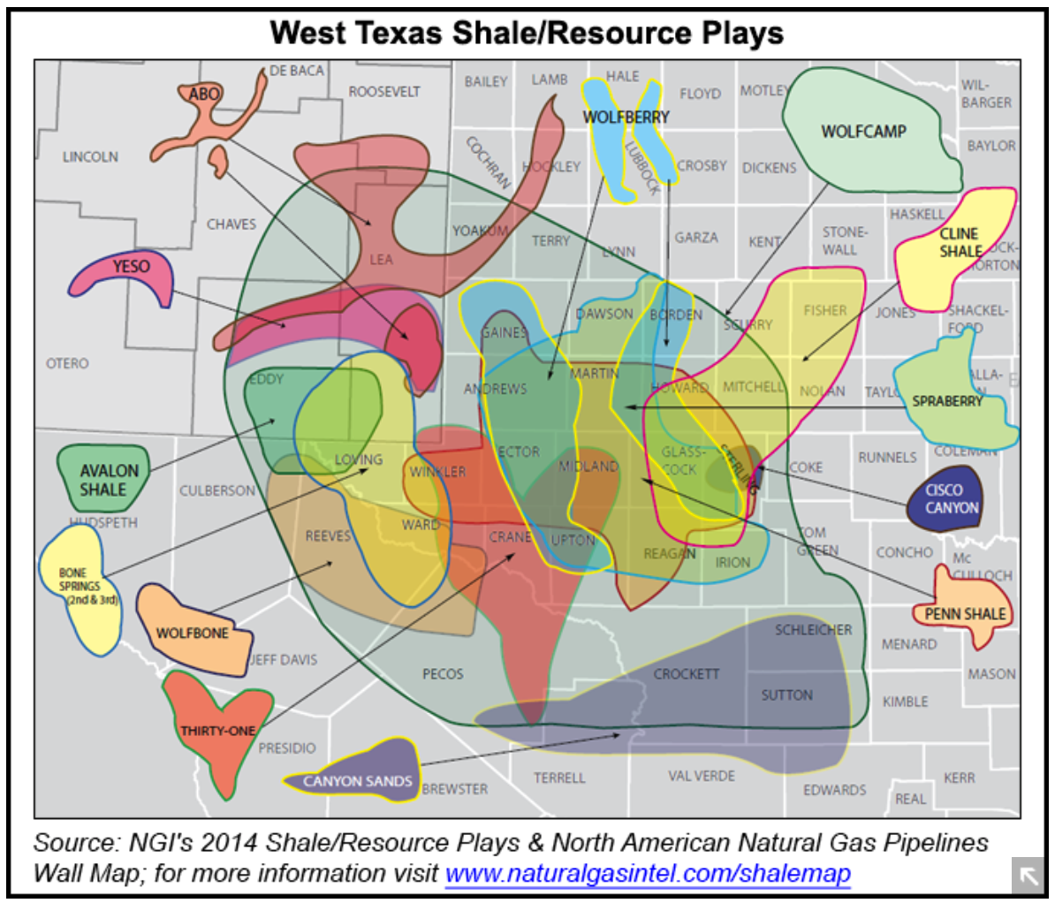
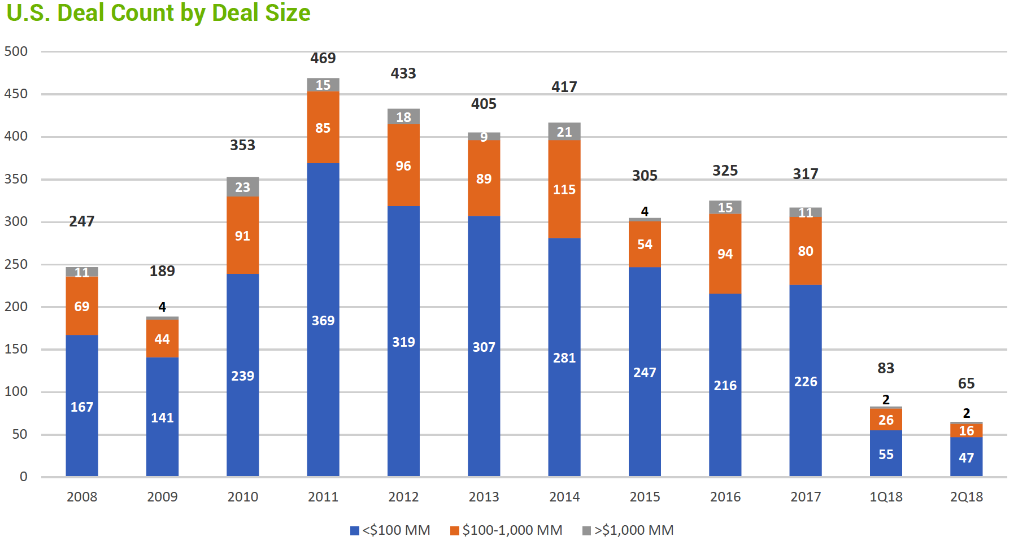
Business Objectives
Find (Cheap) Well Data
Uncover Key Aspects
Produce Quantified Results
Determine Linear Trends
Determine Top Plays
Market Overview
Where to deal and what to play?
Page 3

Slide 4
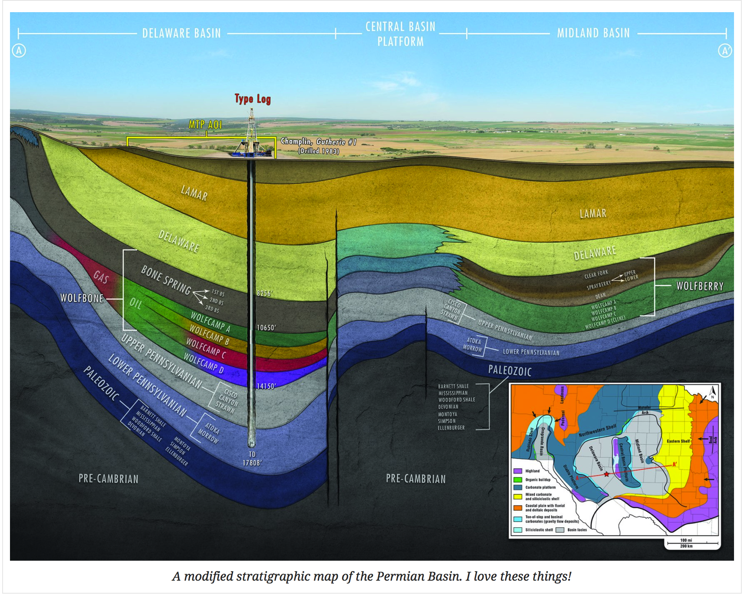
Research Questions
Questions
Does well productivity increase with 'frac size’?
How does it increase?
Are there regional trends?
Trends by formation?
Do additives affect oil productivity?
Page 4

Slide 5
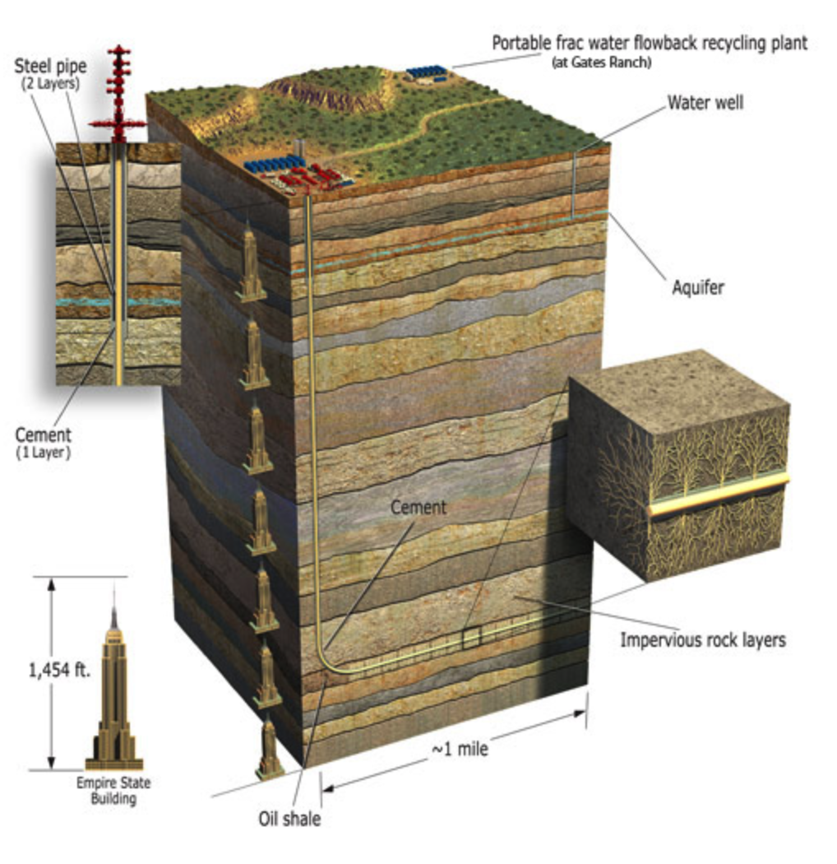
Data Source
Data
Driftwood
fracfocus.org
1,454ft x 5 = ~7300ft =
TVD
Quantify Everything!
Page 5

Slide 6
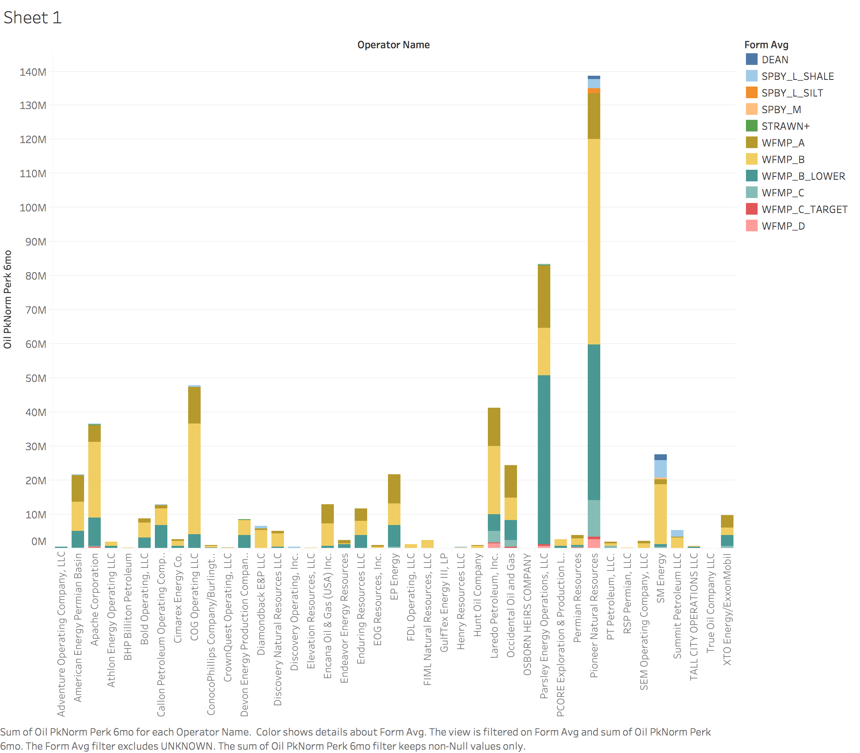
Exploratory Data Analysis
Oil Production by Company
Page 6

Slide 7
Exploratory Data Analysis
Oil Production by Company
Page 7

Slide 8
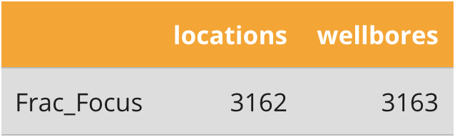
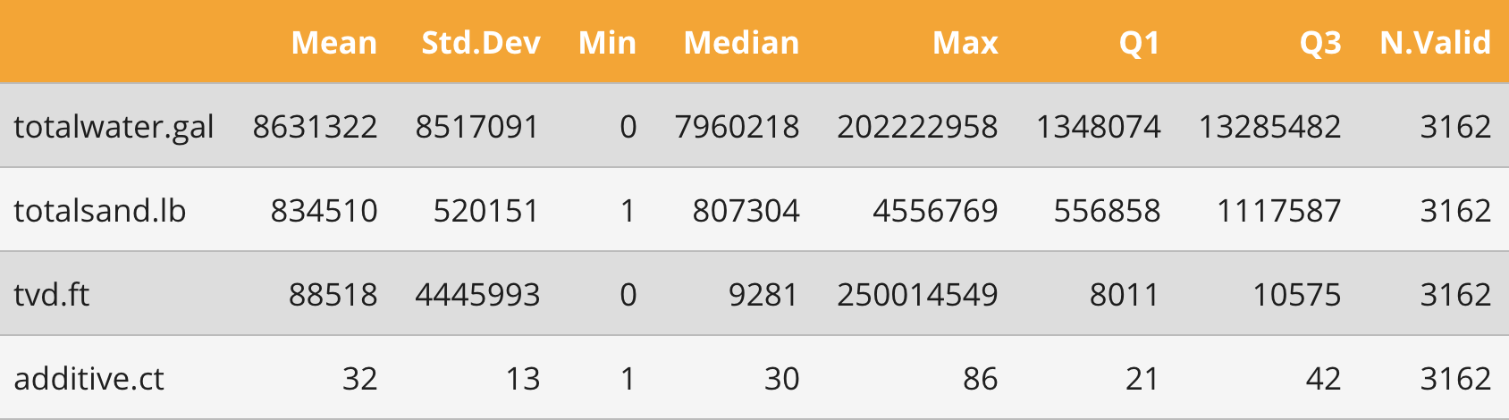
Exploratory Data Analysis
Locations
Aggregate additives
Page 8

Slide 9
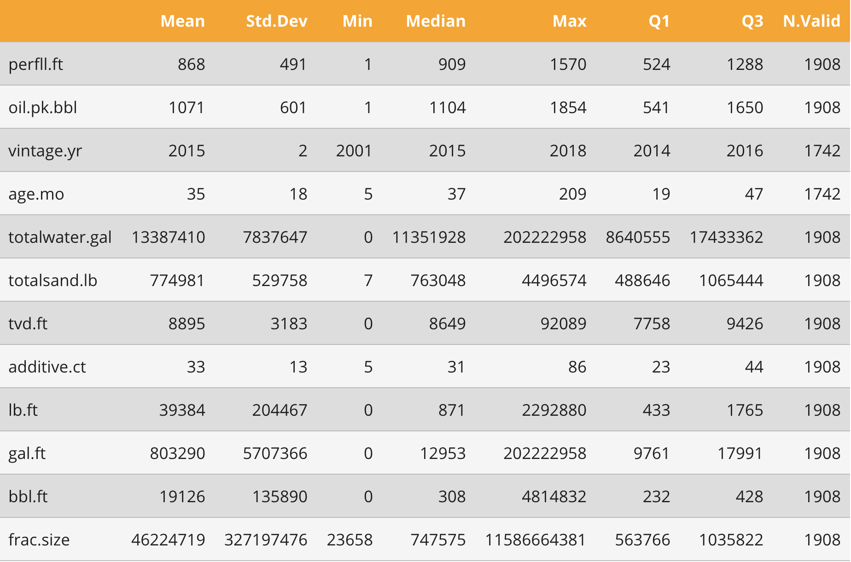
Exploratory Data Analysis
Summary of well data
Page 9

Slide 10
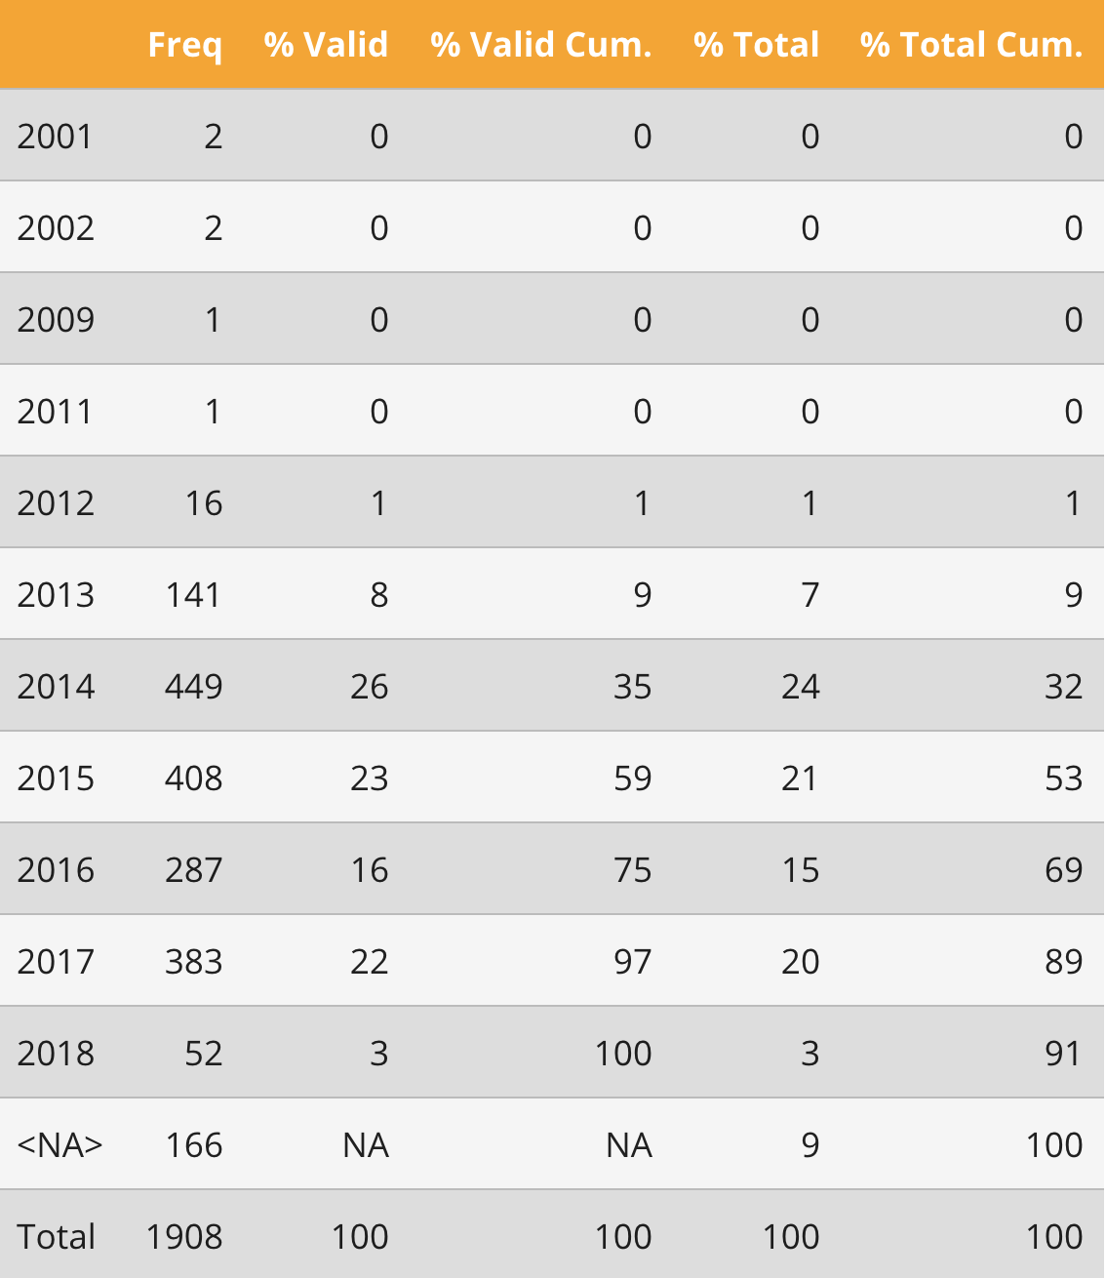
Exploratory Data Analysis
Summary of wells by year
Page 10

Slide 11
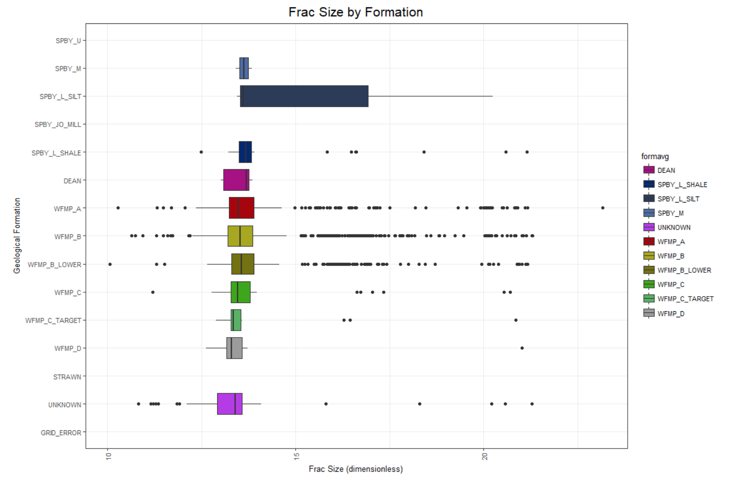
Exploratory Data Analysis
Fracture size by formation
Page 11

Slide 12
Methodology
Steps
Step 1
Step 2
Step 3
Workflow
Step 1
Step 2
Step 3
Page 12
Notes:
Brock
Understand significance of ABV and IBU relationship

Slide 13
Evaluation and Results
Tell me the percentages and why
Show me graphs with explanations
Was your hypothesis correct
Provide any other interesting trends and observations from your analysis
Other things to consider?
Page 13
Notes:
Quinton

Slide 14
Summary
Insights
Recommendations
Improvements
Page 14

Slide 15
Questions
Page 15

